Slide 1
British Airways Data Science
Tsun Li Nicholas Tam

Slide 2
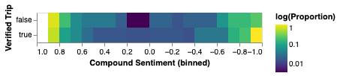
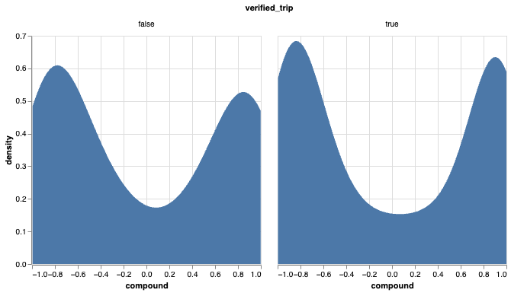
Insights
In general, there are greater proportions of people with more extreme values of compound sentiment than of those with compound sentiment of 0.
Both charts demonstrate that between people with verified trips and those without, those with verified trips have slightly more extreme sentiments, but otherwise the distributions of compound sentiment are relatively similar.

